Slide 1
ERP SYSTEMS USED BY BRANDS
Bussiness Process Engineering
Presented to:
Miss Sobia Iftekhar
Prepared by:
M. Ehtesham Zafar (20k-1655)
Hassan Ali (20k-1052)
Amna Mubarak (20k-1695)

Slide 2
CONTENTS
1
What is ERP system?
2
Tesla & SpaceX
3
ERP used by Tesla and SpaceX
4
North Face Inc.
5
EPICOR ERP software
6
Case Study on Nike

Slide 3

WHAT IS ERP SYSTEM?
Enterprise resource planning (ERP) is a type of software system that helps organizations automate and manage core business processes for optimal performance.
ERP software coordinates the flow of data between a company’s business processes, providing a single source of truth and streamlining operations across the enterprise.
It’s capable of linking a company’s financials, supply chain, operations, commerce, reporting, manufacturing, and human resources activities on one platform.

Slide 4
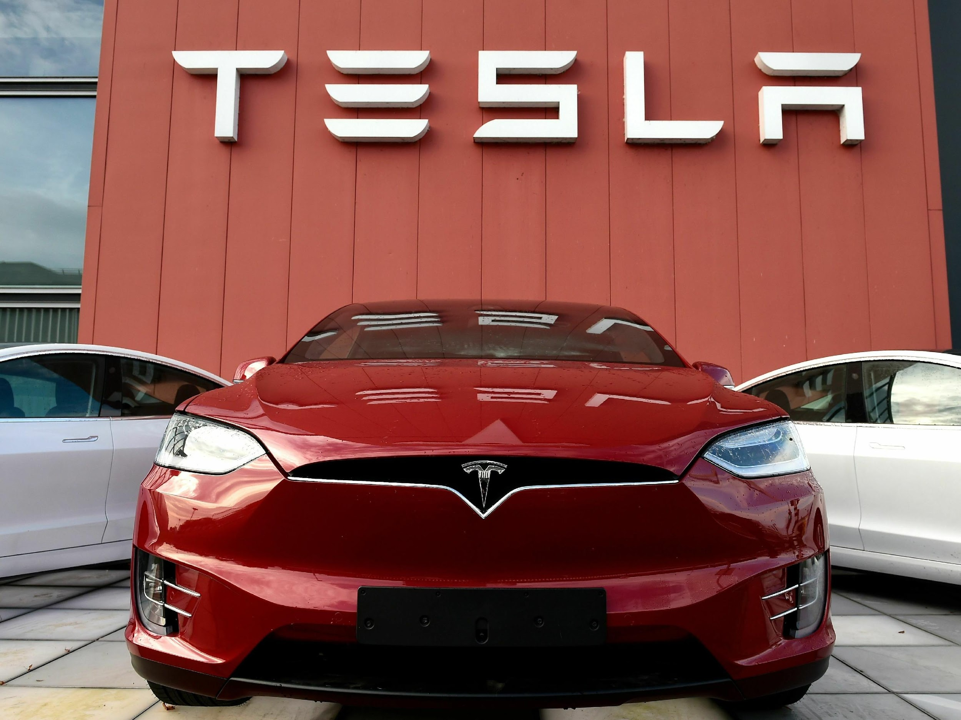
TESLA & SPACEX
Tesla Inc (Tesla) is an automotive and energy company. It designs, develops, manufactures, sells, and leases electric vehicles and energy generation and storage systems. The company produces and sells the Model Y, Model 3, Model X, Model S, Cybertruck, Tesla Semi, and Tesla Roadster vehicles.
(SpaceX) is an American spacecraft manufacturer, launcher, and a satellite communications corporation headquartered in Hawthorne, California. It was founded in 2002 by Elon Musk with the stated goal of reducing space transportation costs to enable the colonization of Mars.

Slide 5

WARP DRIVE
Tesla's entire financial and operational system is completely internally-generated and integrated via its ERP software they developed in-house called Warp.
Warp enables real-time, collaborative, and synced operations for a seamless workflow across Tesla production and staff functions.
It uses several technologies including: AngularJS, Node.js, Redis Cache, Socket.io (for the dashboard), AWS SNS (for datapoint notifications), AWS Lambda (for some system automation tasks) and others.

Slide 6
WARP SUB SYSTEMS
WARP® CRM - Customer Relationship Management
1
WARP® INSA - Insurance Portfolio Management
2
WARP® PROL - Payroll
3
WARP® INVC - Invoicing & Receipts
4
WARP® ACC - Accounting, (Includes INVC)
5
WARP® STKI - Stock Interchange
6

Slide 7
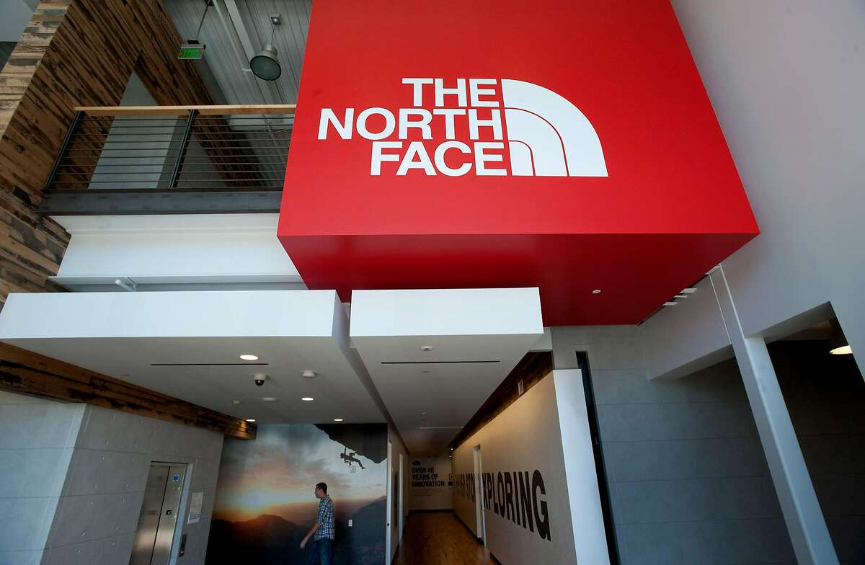
North Face Inc.

Slide 8
North Face Inc.
The North Face is an American outdoor recreation products company.
The North Face produces outdoor clothing, footwear, and related equipment.
It was Founded in 1968 to supply climbers, the company's logo draws inspiration from Half Dome, in Yosemite National Park.
By the late 1990s, the label had expanded beyond outdoor enthusiasts by focusing on street couture and since the 2000s it is regarded as a streetwear style symbol label.
In 2000, it was bought by VF Corporation.

Slide 9
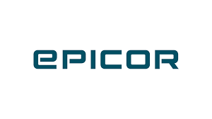
EPICOR ERP Software
North face uses EPICOR ERP software to improve communication across departments and optimize business processes by providing easy visibility of all operations.
The modular, industry-specific Epicor ERP system is utilised throughout the whole organisation to handle business activities.
The management of accounting and finance, human resources, clients, the supply chain, inventory, distribution, and manufacturing production management are all areas where Epicor software excels.

Slide 10
CASE STUDY ON NIKE
From i2 to SAP Apparel and Footwear Solution(AFS)
Tackle the Problem of Nike Supply Chain

Slide 11
REASON FOR i2’s FAILURE FOR NIKE
01
02
03
Problem in smooth integration
Inadequate information
Changing market conditions
04
05
06
Complication of Nike Supply Chain (NSC) project
Review Meetings
Trying to forcast too far out ahead
07
08
09
Inexpierence of i2
Customization
Third party integration

Slide 12
REASON FOR SAP (AFS) SUCCESS
01
02
03
Better financial management
Improved revenue forcasting
Decrease inventory level
04
05
06
Quicker maufactoring and design process
Better integration between various departments
Improved level of decision making
07
Better visibility in customer order transactions

Slide 13
Thanks

